Slide 1
General P-Card Training

Slide 2
Index
  Annual NYS P-Card Guidelines Review
  Certifying Your P-Card
  Account Funding Override
  JPMC – PaymentNet
  Digital Packets
  Signatures
  Reduce File Sizes
  Card-Sharing
  Split Ordering
  Shipping & Freight Costs
  Credit Card Fees
  Misuse & Consequences
  FAQs
  Subscriptions/Renewals/IT
  “Click-Wrap” Agreements
  Travel-Related Purchases
  Allowable Use of Funds
  Alternate Funding Sources
  ROPC
  Apparel
  Furniture
  Amazon Business
  Preferred Sources
  Deactivation Form
  P-Card Toolbox
  Audits
  Contacts

Slide 3
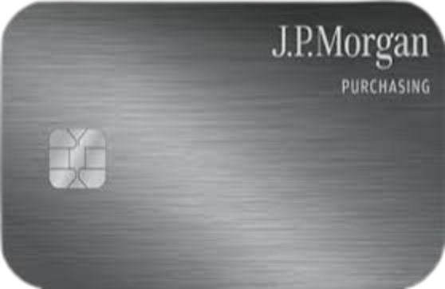
Annual NYS P-Card Guidelines Review
What is it?
  Mandatory annual review of NYS P-Card policies
  Ensures cardholders and supervisors understand:
    Proper use of P-Card
    Allowable vs. unallowable purchases
    Documentation and reconciliation requirements
Why is it required annually?
  Maintains compliance with NYS regulations & SUNY policies
  Keeps cardholders informed on policy updates or changes

Slide 4
Certifying Your P-Card
What does “certifying” mean?
  Reviewing and confirming that all P-Card transactions are accurate and appropriate.
  Ensuring each charge has proper documentation and a business purpose.
  When do you certify?
    After receiving notification from myself, the P-Card Admin - NOT immediately when your JPMC statement becomes available.
  Why is certification important?
    Confirms purchases are valid SUNY business expenses.
    Ensures accuracy before payment is processed.
    Required for audit compliance.
    Helps prevent errors, misuse, or missing documentation.
  Instructions to certify
  How-to Video to change a dept. account # (this can be done PRIOR to FMS certification)

Slide 5
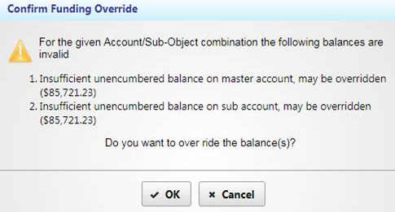
Account Funding Override
When certifying:
  DO NOT CLICK “OK”
  Send a screenshot to P-Card Admin (include account #)

Slide 6

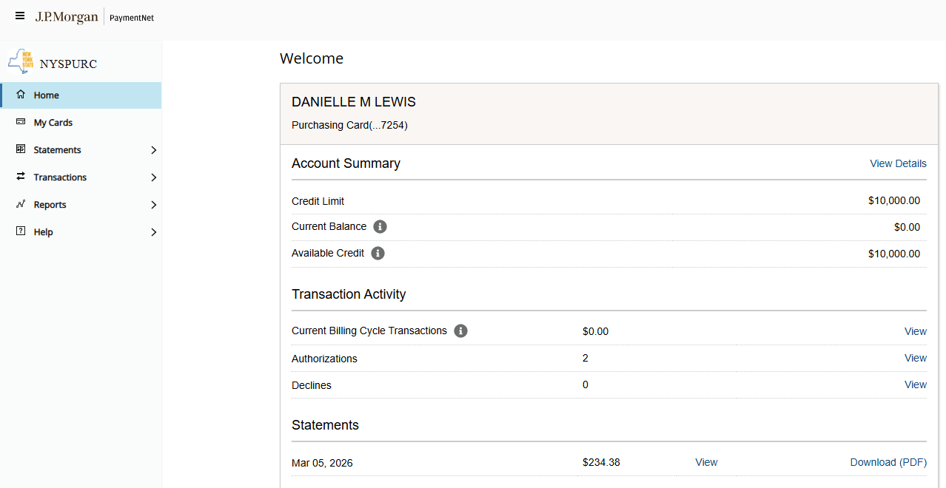
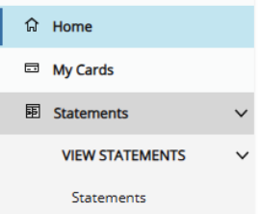
JMPC - PaymentNet
To view your statements, click Statements and at the bottom, you can view your most current statement and download the PDF.
To view previous statements, in the left-hand sidebar, under Statements, click the dropdown arrow and under View Statements, click Statements.

Slide 7
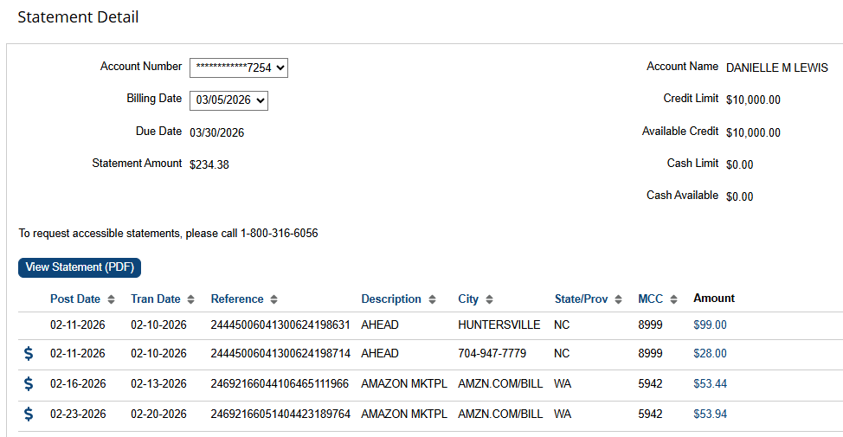
JMPC - PaymentNet
To view previous statements, select the statement date you want to review under Billing Date at the top.
Click on “View Statement (PDF)” beneath to view the entire statement or review the transactions on the screen as shown here.
On the current statement, review transactions for any suspicious or unauthorized activity.

Slide 8
Digital P-Card Packets
Why have we gone digital?
  Improves efficiency – faster submission and approval process
  Enhances organization – all documents are stored in one place
  Reduces paper use – more sustainable and cost-effective – our office is completely paperless
  Simplifies audits – easier to review, track, and retrieve records
Tips to create an organized digital packet
  Best Practices:
    Gather documentation (clear & legible itemized receipts, business purposes, any required approvals, etc.)
    Keep file names consistent
    Double-check transactions match bank statement
    Attach FMS Certification page

Slide 9
Digital P-Card Packets
Dropbox Instructions
  https://www2.cortland.edu/offices/purchasing-office/p-card-faqs#digital-p-card-packet-submission-instructions
    Under Digital P-Card Packet Submission Instructions

Slide 10
How to Add your Scanned Signature into Adobe Acrobat
Instructions:
https://www2.cortland.edu/offices/purchasing-office/how-to-add-your-scanned-signature-into-adobe-acrobat

Slide 11
Reducing PDF File Sizes
Large PDF files can:
  Cause upload issues into Dropbox
  Delay audit reviews
  Consume unnecessary storage space
Quick Tips
  When scanning documents:
    Remove blank pages
  Saving PDFs
    Use “Reduce File Size”

Slide 12
What is Card-Sharing?
Definition:
  P-Card is used by anyone other than the individual whose name appears on the card. Card-sharing is expressly prohibited.
What counts as card-sharing?
  Letting someone else "place the order for you" by giving them your physical card or giving them the card details.
What to do instead
  If the P-cardholder is unavailable or out of the office, someone in the dept./office may reach out to the P-Card Administrator and they will be able to review and place the order with their own P-Card and charge to your account.
Why it’s not allowed
  Violates SUNY & NYS internal control standards.
  Increased risk of:
    Fraud
    Unauthorized purchases
    And data breaches
Key takeaway: If you didn't place the order yourself, it's a violation.

Slide 13
What is Split Ordering?
Definition
  Separating one purchase into multiple P-Card transactions to avoid procurement rules or spending limits.
Examples
    Splitting a $1,000 purchase into two $500 charges to stay under the single-purchase limit.
    Making smaller purchases to avoid quote requirements.
    Placing repeated orders for the same items when the total need was known in advance.
Why it’s not allowed
  Circumvents procurement policies and approvals
  Violates P-Card and State purchasing rules

Slide 14
Shipping Address & Freight Costs
All shipments must be delivered to a valid campus address, preferably Central Receiving (3739 Stratton Drive, Cortland).
Freight or shipping invoices are required for any shipment over $500.

Slide 15
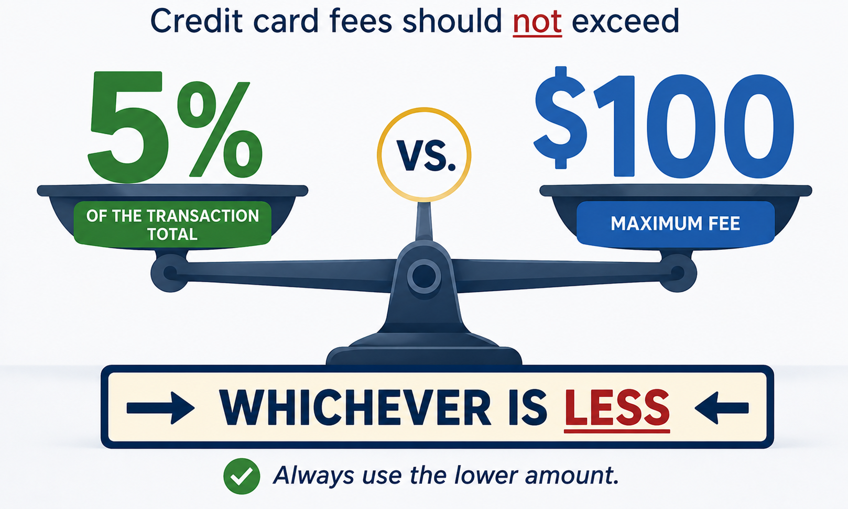
Credit Card Fees

Slide 16
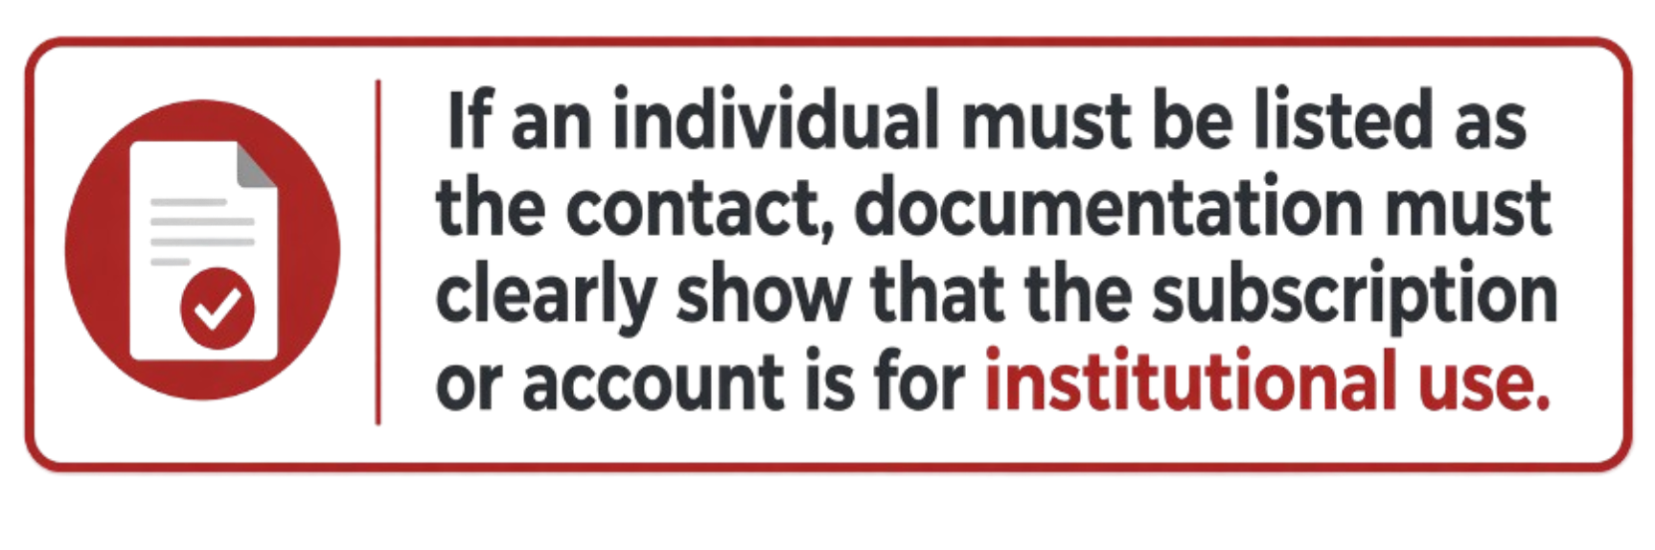
Individual vs. Campus Account Setup
❌Avoid This 👤
Personal / Individual Account
Account under individual’s name
No business/department listed
Why?
Can create tax issues
Can appear personal during audit review
✅ Preferred Setup 🏫
Campus / Institutional Account
Business name = SUNY Cortland
Include department name
Institutional contact information

Slide 17
P-Card Misuse & Consequences
What is Misuse?
  Violating SUNY / NYS / P-Card guidelines
  Prohibited purchases (personal, travel, etc.)
  Splitting transactions to bypass limits
  Sharing your card
Consequences
  1st Offense: Warning + must reimburse
  2nd Offense: 1-month card suspension
  3rd Offense: Permanent revocation of card
  👉 Cardholder is responsible for ALL unauthorized charges

Slide 18
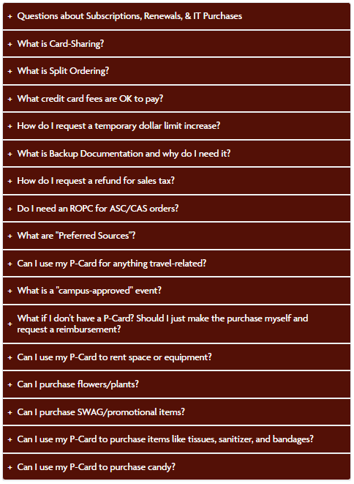
FAQs
We’re always adding to this, so check back often.
https://www2.cortland.edu/offices/purchasing-office/p-card-faqs

Slide 19
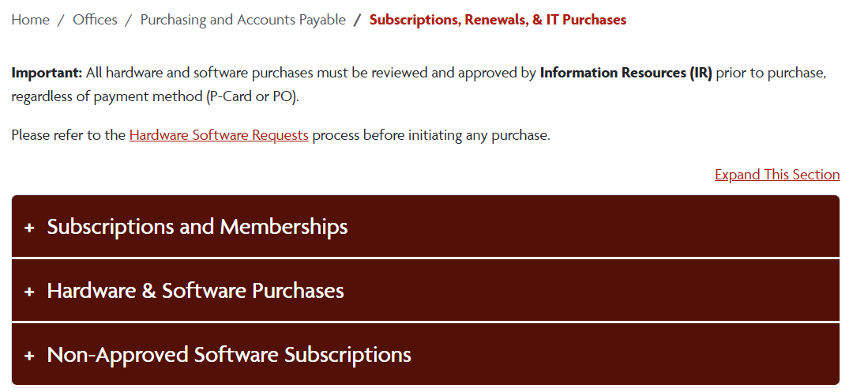
Subscriptions, Renewals, IT Purchases
  https://www2.cortland.edu/offices/purchasing-office/subscriptions-renewals-it-purchases

Slide 20
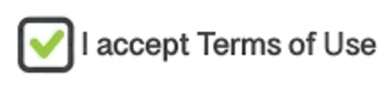
“Click-Wrap” Agreements
What is “Click-Wrap”?
  Clicking “I Agree” or completing an online purchase may accept legal terms & conditions.
Important Reminders
  Online purchases include legal terms via URL links or checkboxes
  P-Card holders are not authorized signers for the College
    Accepting terms may create liability for you and the College
  Review terms carefully and send to Purchasing if needed.
Refer to the Signature Authority Policy or contact Purchasing.

Slide 21

Travel-Related Purchases
A P-Card cannot be used for travel
A P-Card may be used to pay conference registration fees.
  See Conference Registration Fees for more information.
Travel/NET Card Program for authorized travel expenses.
  See Travel and NET Card Guidelines for more information.
Bottom line: P-Cards are not for travel, except for approved conference registration.

Slide 22

Allowable Use of Funds
General Rule
  Purchases must be necessary and reasonable
  Directly support University business
  Be cost-effective and economical
  Allowable Use of Funds
Decision Check
Is it necessary for my job or department?
Is this the most economical option?
Would this hold up in an audit?
⚠️ When in doubt → ask before you buy

Slide 23

Alternate Funding Sources
What are we referring to?
  Research Foundation (RF)
  CAS/ASC Accounts
  Foundation Accounts
Each funding source has its own rules and restrictions, so before making a purchase, it’s important to confirm that the expense is allowable and that the proper approvals are in place.
*Always verify allowability and approval requirements prior to purchase.

Slide 24
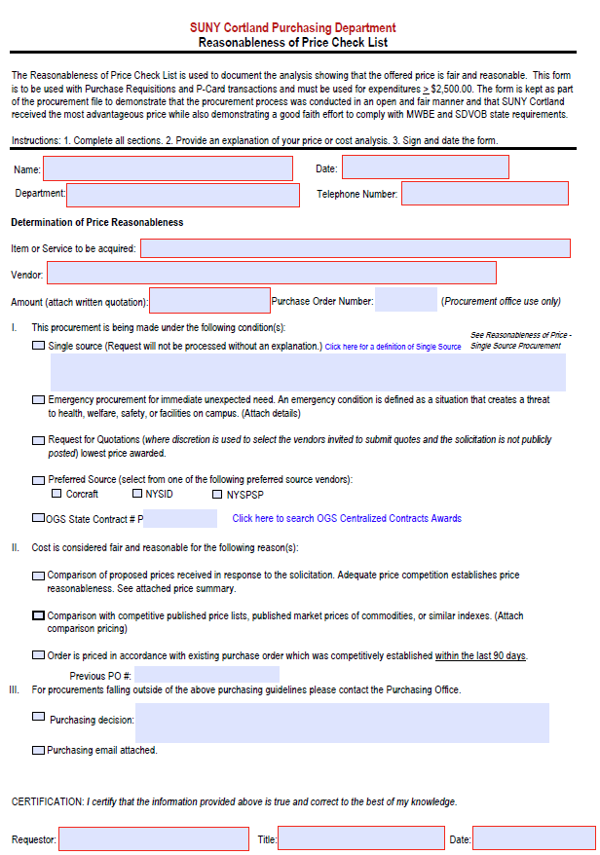
Reasonableness of Price Checklist (ROPC)
ROPC
Required for ALL orders of $2,500 or more
Preferred – obtain 3 quotes
  Published Price Lists / Internet searches may be accepted when quotes not feasible
Why do we need it?
  Analysis showing that the offered price is fair and reasonable
    Demonstrates that the procurement process was conducted in an open and fair manner and that SUNY Cortland received the most advantageous price.

Slide 25

Apparel Purchases
Must be purchased through a Purchase Order (PO) in Red Dragon Depot (RDD)
Why?
  Weren’t using NYSID (Preferred Source) or getting a waiver
  Weren’t providing proper backup documentation
  We need to monitor the $50 limit/person/year
  Webstores were being created through vendors
  Best way to monitor was to eliminate P-Card purchase and only go to Purchase Order.

Slide 26

Furniture Purchases
Furniture may NOT be purchased with a P-Card
  Includes:
    Desks
    Office chairs
    Filing cabinets
    Standing desks
Unlike regular office supplies, furniture needs to be reviewed to make sure it:
  actually fits the space,
  doesn’t block access,
  matches campus standards,
  includes delivery & installation,
  uses approved vendors, and
  State contract compliance.
Furniture Policy

Slide 27

✔️ DO:
Use Amazon Business via RDD Catalog
Ensures tax-exempt purchases
Ships directly to campus address
❌ DON’T:
Do NOT use personal Amazon accounts
Do NOT pay sales tax
Do NOT ship to home/personal addresses
👉 Always use RDD’s Amazon to stay compliant

Slide 28

Preferred Sources
Who are they?
The reason they are called “Preferred Sources”:
NYS law requires us to purchase from them first, before going out to other vendors, if they offer the product or service we need.
  They are NYS’s Preferred Sources (not necessarily yours)
  This isn’t just a recommendation; it’s a legal requirement.
  https://www2.cortland.edu/offices/purchasing-office/preferred-sources.dot

Slide 29
Preferred Sources
Why do we have to use them?
Purchases from Preferred Sources take precedence over all other sources of supply and competitive procurement methods.
When can I move on to another option?
    Only if they can’t meet your form, function, or utility.
      Form: Color, shape, configuration, etc.
      Function: Purpose, ability to work in a specific way, etc.
      Utility: Usefulness, availability, function, etc.

Slide 30
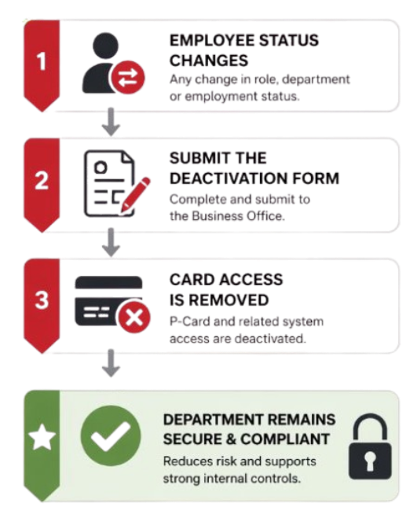
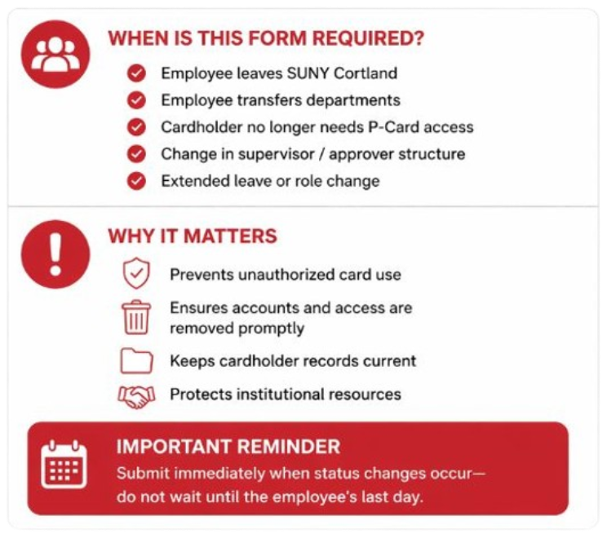
Business Office Deactivation Form
Business Office Deactivation Form

Slide 31

P-Card Toolbox
Buyer’s Guide: P-Card 101
Cardholder Manual
Checklists
FAQs
Forms/Logs
P-Card Guidelines
Trainings & How-to Videos
P-Card Administrator

Slide 32


Why We Ask for Backup Documentation
Why are we asking for backup documentation all the time?
SUNY is regularly audited by the NYS Office of the State Comptroller (OSC).
  During those audits, transactions are reviewed based solely on the documentation our office provides.
  Auditors don’t have access to our internal conversations or the story behind the purchase, so if something isn’t clearly documented to us initially, it can be considered non-compliant, even if the purchase itself was appropriate.
The goal is to make sure:
  We meet audit standards.
  Cardholders are protected from follow-up questions or findings.
  University stays in good standing with OSC.

Slide 33

Contacts
Danielle Lewis
P-Card Administrator
x2407
danielle.lewis@cortland.edu
Casey Avery
Associate Director of Purchasing & AP
x2307
casey.avery@cortland.edu
P-Card Website: https://www2.cortland.edu/offices/purchasing-office/p-card-guidelines.dot
Purchasing & AP Staff: https://www2.cortland.edu/offices/purchasing-office/purchasing-staff.dot

